Slide 1
CS143 Week#3 (Disk)
Jia (Jason) Teoh
slides courtesy of Ariyam Das
Notes:
We did cover indexes in class on Wednesday, but those are a bit more in-depth so we’ll cover them in detail next week. If interested we can go through an overview of sparse vs dense today (ISAM/B+ next week though)

Slide 2
Announcements
Discussion 2B (2-3:50) cancelled.
Feel free to attend any of the other two discussions.
Project 2B released
Due Monday October 30th @ 11PM on CCLE
Post questions on Piazza
Notes:
Um... I guess hw 2 was also due right at the moment Jason teaches his discussion. so not exactly worthwhile to mention that...
all slides uploaded to CCLE later.
also, everybody has signed up on Piazza right? RIGHT?! yay.
(does anybody else actually read these notes?)

Slide 3
SQL - Cubes and Rollups
FYI
https://technet.microsoft.com/en-us/library/ms189305(v=sql.90).aspx

Slide 4
SQL Authorization
See handout (w3_1.pdf)

Slide 5
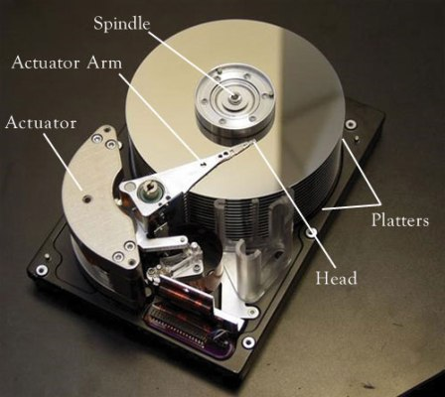

Slide 6
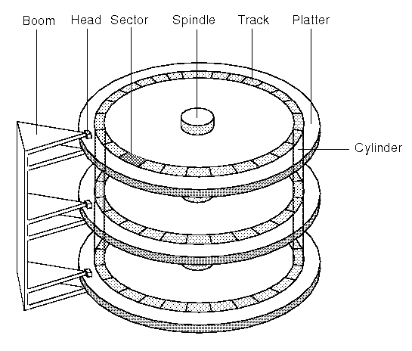

Slide 7
A typical disk
2 platters
2 surfaces/platter
5000 tracks/surface
1000 sectors/track
1KB/sector
6,000 RPM (rotational speed)

Slide 8
Overall Capacity
Q: 2 platters, 2 surfaces/platter, 5000 tracks/surface, 1000 sectors/track, 1KB/sector. What is the overall capacity?
2 platters * 2 surfaces/platter * 5000 tracks/surface * 1000 sectors/track * 1KB/sector = 20 * 1000 * 1000 KB = 20 GB
Notes:
easy – just multiply them all together

Slide 9
Access Time
Access time =
(seek time) + (rotational delay) + (transfer time)

Slide 10
Seek Time
Seek time: time to find the target track
Typical average seek time: 10 ms
Notes:
for any hw/test questions we’ll give you the information needed to calculate though.

Slide 11
Rotational Delay
Head Here
Block I Want
Rotational delay: time to rotate to the target sector
For 6000 RPM, average rotational delay=0.5*(1min/6000)=0.5*60sec/6000=5 ms
Notes:
Why 0.5? we’re assuming random access on the disk, so on average it’ll end up halfway around the disk (thus you need half a rotation)

Slide 12
Transfer Time/ Rate
Read blocks as
the platter rotates
Disk Head
[6000 RPM, 1000 sector/track, 1KB/sector]
Time to read one block
Read a track, rotate a circle: 1min/6000 = 10 ms/track
Read one sector(block): (10ms/track) / (1000sector/track) = 0.01ms/sector
Transfer rate: 1KB/(0.01ms/sector)=100MB/s
Notes:
reading the whole track = RPM
sector (aka block) is a fraction of the track
transfer rate: read time for a block combined with the data in a block

Slide 13
Sequential Access
Time to read 3 sequential blocks
seek time: 10 ms
rotational delay: 5 ms
transfer time: 0.01ms
Access time:
10ms+5ms+3*(0.01ms)= 15.03ms

Slide 14
Random Access
Time to read 3 random blocks
seek time: 10 ms
rotational delay: 5 ms
transfer time: 0.01ms
Access time:
(10ms+5ms+0.01ms)*3=45.03ms
Very expensive, avoid random I/O as much as we can

Slide 15
Answer query: Full Search v/s Index
SELECT * FROM Student WHERE sid = 40
sid | name | GPA
20 | Elaine | 3.2
70 | Peter | 2.6
40 | Susan | 3.7
Notes:
That’s all I have for slides right now. Is there other stuff you guys want to cover?
Optional adhoc review: sparse vs dense index
dense: entry for every single record
sparse: entry for head of every block (really only makes sense if blocks are sequential)
multi-level index: used so highest level index can still be stored in memory, reduce page loads for lookup
first-level (lowest/closest to data blocks) must be dense if used in a secondary index, since the data isn’t clustered (ie sequential keys might point to opposite ends of the table)

